Slide 1
LibreOffice Python - Part 4 -Version 2
Writing a Python Program for LibreOffice that is stored in the Document library. i.e. Embedded in the document file.
Version 2 – Changes:
Add a console command line interface. This uses the argparse module.
Perform modifications to the Manifest and Content XML files using the lxml module.
Example program is now named: user2document.py
Hamilton Python User Group Presentation
2015 May 12
Ian Stewart
V2.0
https://github.com/hampug

Slide 2
Introduction: Inside a LibreOffice Document
LibreOffice uses the Open Document Format.
Open Document Format (ODF) is an international family of standards that is the successor of commonly used deprecated vendor specific document formats such as .doc, .wpd, .xls and .rtf. ODF is standardised at OASIS and adopted by ISO/IEC JTC1 SC34. Expect V1.2 ISO/IEC approved in 2015.
http://www.opendocumentformat.org/aboutODF/
Container Structure: ODF Package
Compression Format: ZIP
http://en.wikipedia.org/wiki/OpenDocument
Summary: A LibreOffice file is one zip file of many files and folders. The files extension starts with “.od”. The last character determines the application that created it. For example .odt for text writer, .ods for calc spreadsheet, .odp for Impress presentation, .odg for Draw graphics.

Slide 3
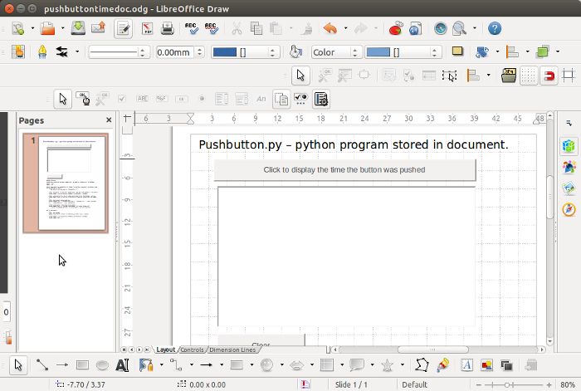
Introduction: Copy example libreoffice document in preparation for embedding python code inside the document.

Slide 4
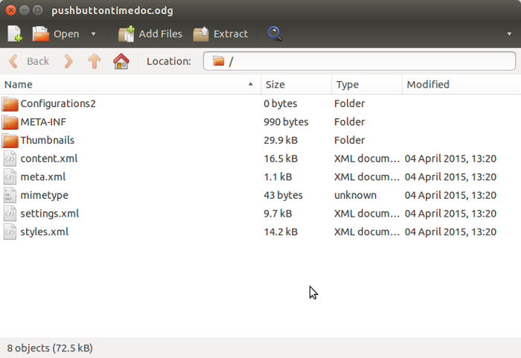
Introduction: Archive Manager view of example LibreOffice document

Slide 5
Steps to move a python program from User Library into the Document library.
Unzip LibreOffice document files into a /tmp/odf subdirectory.
Create in /tmp/odf/ subdirectory the Scripts and python folders.
Copy the python programs from the User library to /tmp/odf/Scripts/python/ folder.
Into manifest.xml file insert the extra python folder and file names.
In the content.xml file, change the event-listeners to be in the document.
Re-zip the /tmp/odf/ files back into a LibreOffice document. The minetype file must be first file in the zip archive.
Performing the above six steps manually at the bash command line is difficult. The next 20 slides describe the python program, user2document.py, that does the above.

Slide 6
Step0: user2document.py command line arguments
Check the path to the Draw document...
$ ls ~/'pyuno for libreoffice'/pushbuttontimedoc.odg
/home/ian/pyuno for libreoffice/pushbuttontimedoc.odg
Change directory to where user2document.py is located...
$ cd ~/.config/libreoffice/4/user/Scripts/python/utility/
Run the user2document.py script...
$ python3 user2document.py pushbutton.py ~/'pyuno for libreoffice'/pushbuttontimedoc.odg
Console message when program runs sucessfully...
Completed embedding : New libreoffice document is located...
odf python file path: /home/ian/pyuno for libreoffice/
odf python file name: pushbuttontimedoc_embedded_python.odg
Python program in User library
Path and filename of libreoffice document

Slide 7
Step0: user2document.py command line arguments
Sample of the argparse module being used to interpret the command line arguments...
import argparse
parser = argparse.ArgumentParser()
args = setup_argparse(parser)
def setup_argparse(parser):
'''
Use argparse module to interpret the command line
'''
# User Library specific file or root folder containing python script(s)
parser.add_argument('python_script', type=str, help=HELP_MESSAGE_1)
# ODF Document file that will have the python scripts embedded in it.
parser.add_argument('odf_document', type=str, help=HELP_MESSAGE_2)
# Optional output file
parser.add_argument('-o', '--output_file', type=str, help=HELP_MESSAGE_3)
For more information type $ python3 user2document.py --help
See the source code of user2document.py for more information on processing the command line arguments.

Slide 8
Step1a: Unzip LibreOffice document files into a /tmp subdirectory
import zipfile
path = "/home/ian/pyuno for libreoffice/"
filename = "pushbuttontimedoc.odg"
temp_directory = "/tmp/odf/"
def unzip(path, filename, temp_directory):
"""
Using the supplied path, unzip the LibreOffice file into the temporary
directory. /tmp/odf/
"""
with zipfile.ZipFile(path + filename, "r") as z:
z.extractall(temp_directory)
The new copy of the python Draw file which still has pushbuttons that use the python script in the User library, is unzipped into a /tmp/odf/ subdirectory.

Slide 9
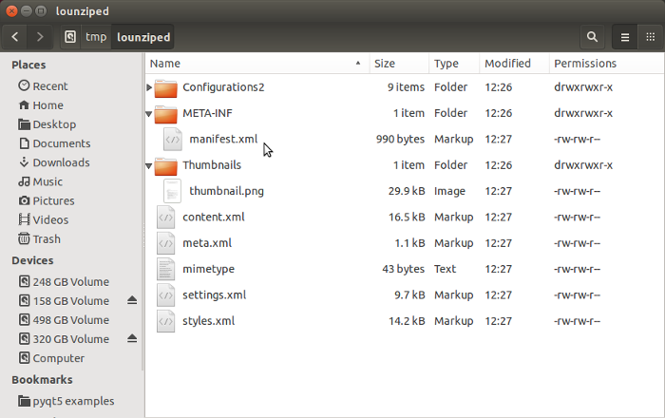
Step1b: View of example libreoffice document unzipped into a /tmp subdirectory.
Files of interest: manifest.xml, content.xml and mimetype
FYI: Configuratons2 contains 9 x subfolders and 1 file.

Slide 10
Step2a: Create in /tmp/odf/ subdirectory the Scripts/python folders.
import os
def copy_python_files(python_list):
'''
Add the paths to temp location and copy the files to temp.
'''
PATH_TEMP_PYTHON = '{}{}'.format(PATH_TEMP, 'Scripts/python/')
os.makedirs('{}'.format(PATH_TEMP_PYTHON), mode=0o777, exist_ok=True)
“Script” folder and “python” sub-folder are created in the /tmp/odf/ subdirectory.
os.makedirs. If exist_ok is False (the default), an OSError is raised if the target directory already exists.

Slide 11
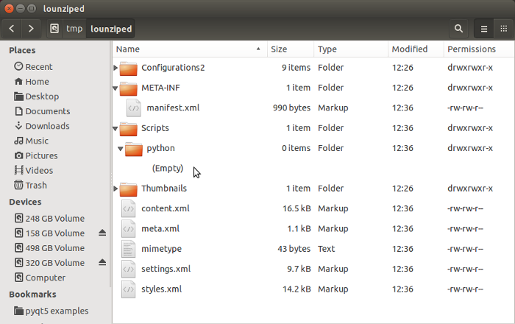
Step2b: Create in /tmp subdirectory the Scripts/python folders.
Scripts and python folders now exists in /tmp subdirectory

Slide 12
Step3a: Copy python program from User library to /tmp/odf/Scripts/python/
import shutil
def copy_python_files(python_list): continues...
# Strip the prefix off the start of the python_list files. Then append
# suffix to PATH_TEMP_PYTHON. Append to temp_python_list
temp_python_list = []
for item in python_list:
temp_python_list.append('{}{}'
.format(PATH_TEMP_PYTHON, item.split(PATH_USER_LIBRARY)[1]))
#Create the directories off the tmp/odf/Scripts/python folder
for item in temp_python_list: # item: messagebox/information/pythoninfo.py
head, tail = os.path.split(item)
os.makedirs(head, mode=0o777, exist_ok=True)
# Copy python files from User Library to unziped odf file
for pointer, item in enumerate(temp_python_list):
shutil.copy2(python_list[pointer], temp_python_list[pointer])
return temp_python_list
Using shutil.copy2 preserves the modified date of the python file. This could help with revision control.

Slide 13
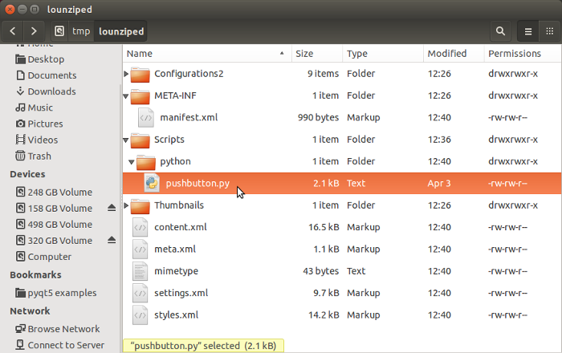
Step3b: Copy python program from User library to /tmp subdirectory /Scripts/python/.
...pushbutton.py now in python directory

Slide 14
Step3a: Copy python program from User library to /tmp/odf/Scripts/python/
import shutil
def copy_python_files(python_list): continues...
# Strip the prefix off the start of the python_list files. Then append
# suffix to PATH_TEMP_PYTHON. Append to temp_python_list
temp_python_list = []
for item in python_list:
temp_python_list.append('{}{}'
.format(PATH_TEMP_PYTHON, item.split(PATH_USER_LIBRARY)[1]))
#Create the directories off the tmp/odf/Scripts/python folder
for item in temp_python_list: # item: messagebox/information/pythoninfo.py
head, tail = os.path.split(item)
os.makedirs(head, mode=0o777, exist_ok=True)
# Copy python files from User Library to unziped odf file
for pointer, item in enumerate(temp_python_list):
shutil.copy2(python_list[pointer], temp_python_list[pointer])
return temp_python_list
Using shutil.copy2 preserves the modified date of the python file. This could help with revision control.

Slide 15
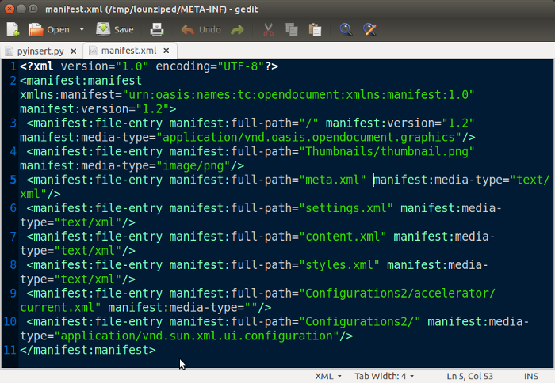
Step4a: Into the manifest.xml file insert the Scripts and python folders and the python file. Before inserting...

Slide 16
Step4b: Into the manifest.xml file insert the Scripts and python folders and the python file.
from lxml import etree
def modify_manifest(temp_python_list):
'''
Append python path and filenames to the manifest file using lxml.
lxml preserves namspaces. E.g. Doesn't change 'manifest' to 'ns0'.
An advantage of lxml module over xml.etree.ElementTree module.
Namespace MANIFEST = '{urn:oasis:names:tc:opendocument:xmlns:manifest:1.0}'
'''
# Variable for path and filename of manifest file in temp directory
manifest_pathfile = '{}{}'.format(PATH_TEMP, 'META-INF/manifest.xml')
# Create a parser that removes any indentations that may already exist.
xml_parser = etree.XMLParser(remove_blank_text=True)
# Create tree using defined parser for easier to read layout in the file.
tree = etree.parse(manifest_pathfile, xml_parser)
root = tree.getroot()
If the manifest doesn't match the contents of the OpenOffice zip file then an error message occurs upon trying to launch the document. Don't leave behind in the /tmp directories old xxx.py~ files, etc., from editing.
Code continues on next slide...

Slide 17
Step4c: Into the manifest.xml file insert the Scripts and python folders and the python file.
# Namespace for "manifest" used in mofiying the manifest.xml file.
MANIFEST = '{urn:oasis:names:tc:opendocument:xmlns:manifest:1.0}'
def modify_manifest(temp_python_list): continues...
# Trim PATH_TEMP prefix off temp_python_list. Create manifest_python_list
manifest_python_list = []
for item in temp_python_list:
manifest_python_list.append('{}'.format(item.split(PATH_TEMP)[1]))
# Append elements to root for each python file path and filename
for path_filename in (manifest_python_list):
root.append(etree.Element(('{}{}'.format(MANIFEST,'file-entry')),
attrib={
('{}{}'.format(MANIFEST,'full-path')) : path_filename,
('{}{}'.format(MANIFEST,'media-type')) : 'text/xml'
}))
# Overwrite manifest.xml with the modified xml tree
tree.write(manifest_pathfile, encoding='utf-8', xml_declaration=True,
pretty_print=True)
...manifest.xml is now updated

Slide 18
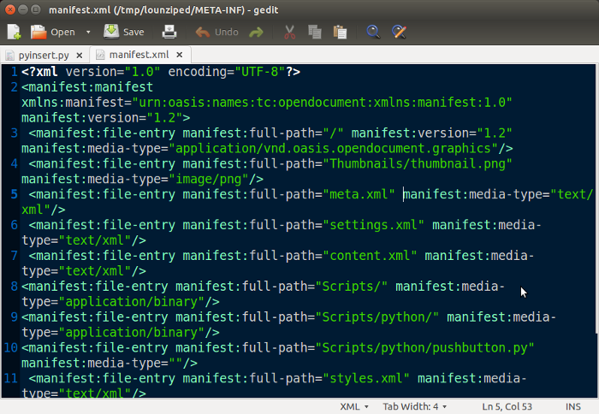
Step4d: Into the manifest.xml file insert the Scripts and python folders and the python file. After inserting...

Slide 19
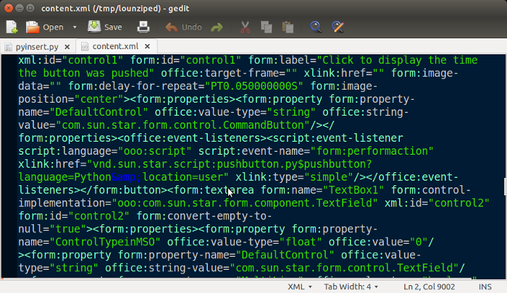
Step5a: In the content.xml file, change the event-listeners to be in the document. Before...
location=user

Slide 20
Step5b: In the content.xml file, change the event-listeners to be in the document..
def modify_content():
'''
Perform modifications of the content.xml file.
Change the content.xml file such that "location=user" is changed to
"location=document". Using lxml. i.e. from lxml import etree
# Reference: http://lxml.de/xpathxslt.html#namespaces-and-prefixes
# Replacement strings USER = 'location=user' DOCUMENT = 'location=document'
'''
if args.verbose: print('\nFunction : modify_content()')
# Define the path and filename of file to be modified
content_pathfile = '{}{}'.format(PATH_TEMP, 'content.xml')
if args.verbose: print('content_pathfile : {}'.format(content_pathfile))
# Create a parser to remove any indentations that may already exist
xml_parser = etree.XMLParser(remove_blank_text=True)
# Create tree using defined parser
tree = etree.parse(content_pathfile, xml_parser)
# Assign the root of the tree
root = tree.getroot()
User library xml listener-event link for the pushbutton: xlink:href="vnd.sun.star.script:pushbutton.py$pushbutton?language=Python&amp;location=user"
Code continues on next slide...

Slide 21
Step5c: In the content.xml file, change the event-listeners to be in the document..
def modify_content(): continues...
# Locate using xpath the "event-listener" elements using namespaces.
# The event-listener with "script" namespace, should have 4 x attributes.
# Two attributes use "xlink:href" and two use "script".
event_listener = root.xpath('//script:event-listener[@xlink:href]',
namespaces={
'script':'urn:oasis:names:tc:opendocument:xmlns:script:1.0',
'xlink':'http://www.w3.org/1999/xlink'})
# Iterate through the items of each event-listener. Each event-listener
# item is a list of 4 x tuples containing key/value pairs.
# If the substring "location=user" is found in one of the values
# replace it with "location=document". Set the new value using the key.
# Event_listener requires an index. E.g. event_listener[i]
counter = 0
for i in range(len(event_listener)):
for key, value in event_listener[i].items():
if USER in value:
value = value.replace(USER, DOCUMENT)
event_listener[i].set(key, value)
counter +=1
# Over-write the tree back to the content.xml file.
tree.write(content_pathfile, encoding='utf-8', xml_declaration=True,
pretty_print=True)
...content.xml is now updated

Slide 22
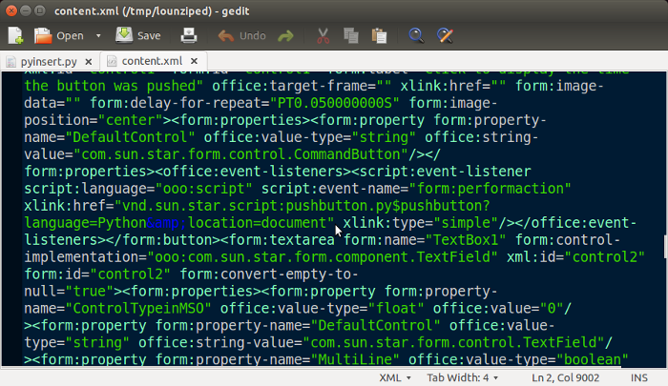
Step5d: In the content.xml file, change the event-listeners to be in the document. After...
location=document

Slide 23
Step6a: Re-zip the /tmp files back to a LibreOffice document Minetype file must be first file.
import os
import zipfile
import shutil
temp_directory = "/tmp/odf/"
pathnew = "/home/ian/pyuno for libreoffice/"
filenamenew = "pushbuttontimedoc_embeddedpy.odg"
def rezip(temp_directory, pathnew, filenamenew):
"""
Using the supplied path into /tmp, rezip the LibreOffice files.
The minetype file must be the first file in the zipped libreoffice
document.
Remove all files in /tmp
"""
# Walk the directory and retrieve a list of all paths and paths/filenames
retrieve_list = []
for root, dirs, files in os.walk(temp_directory, topdown=True):
# Retrieve the paths
for dir_name in dirs:
retrieve_list.extend([os.path.join(root, dir_name)])
# Retrieve path and filename
for file_name in files:
retrieve_list.extend([os.path.join(root, file_name)])
Code continues on next slide...

Slide 24
Step6b: Re-zip the /tmp files back to a LibreOffice document Minetype file must be first file.
import os
import zipfile
import shutil
def rezip(temp_directory, pathnew, filenamenew): continues...
# Create an archive list with pairs of data. E.g.
# [['/tmp/odf/mimetype', 'mimetype']
# ['/tmp/odf/content.xml', 'content.xml']]
# item[0] is the source in /tmp folder.
# item[1] is the destination used in the zip archive
archive_list = []
for item in retrieve_list:
# Remove the /tmp directory data from the start of item.
output = item[len(temp_directory):]
archive_list.append([item, output])
# Shift mimetype to the front of the archive_list so it will be first
# file written into the zip archive.
for pointer, item in enumerate(archive_list):
if item[1] == 'mimetype':
archive_list.insert(0, archive_list.pop(pointer))
Code continues on next slide...

Slide 25
Step6c: Re-zip the /tmp files back to a LibreOffice document Minetype file must be first file.
import os
import zipfile
import shutil
def rezip(temp_directory, pathnew, filenamenew): continues...
# Use the archive_list to build the new libreoffice zip file
# Opening new zip file as "w" removes previous version of file if it exists
with zipfile.ZipFile(pathnew + filenamenew, 'w') as rezipfile:
for item in archive_list:
rezipfile.write(item[0], item[1])
# Clean up. Remove the files that were in /tmp
shutil.rmtree(temp_directory)
...new LibreOffice document is now complete. Launch it and check the code

Slide 26
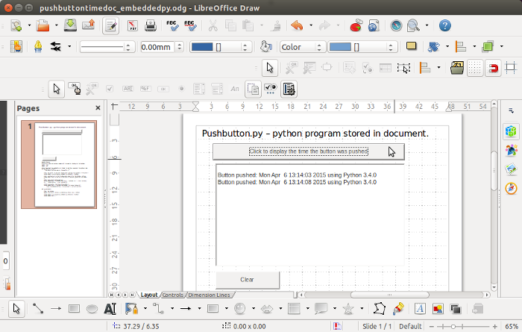
Step6d: Re-zip the /tmp files back to a LibreOffice document. Launch libreoffice document and click button...
Python code now executing from source embedded in document

Slide 27
End of Embedding the python code into a LibreOffice document
Some Observations:
No console window to see stdout. E.g. print(“hello”) disappears. Workaround write to a file and refresh the editor that has the file open.
Code running from a libreoffice library can not import a module that is in the library. Adding __init__.py didn't help. Need to define path?
Only one concatination with a colon. E.g. This won't work if DEBUG: with open('/tmp/debug_info.txt', 'w') as f: f.write('something gone wrong')
Case sensitivity python/libreoffice.

Slide 28
Embedding the python code into a LibreOffice document
That ends the ways LibreOffice connects to python scripts in User, Share and Document macro libraries.
Next Month it's the opposite:
How a python script connects to LibreOffice!
(...which is much more simple and easier to understand)
user2document.py is available on https://github.com/hampug
#TODO:
Provide a GUI (e.g. tkinter) for user2document.py
__end__

